Slide 1
Introduction to Natural Language Processing
Paper Presentation
Members: 110550108 施柏江 110550068 王振倫 110550052 楊沁瑜 110550001 楊佳翰

Slide 2
What the DAAM:
Interpreting Stable Diffusion
Using Cross Attention

Slide 3
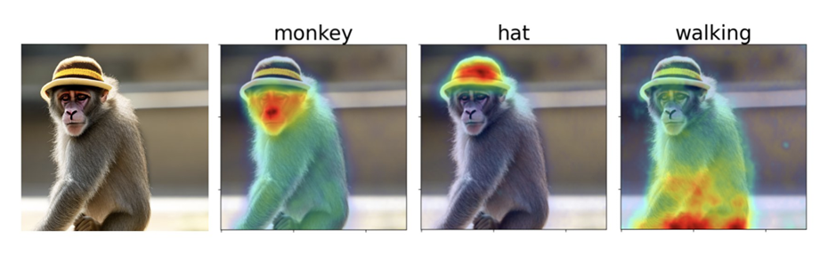
Introduction
Diffusion Models
Google’s Imagen and OpenAI’s DALL-E excel in converting text to images but remain complex to study
Open-Source Contribution
Stable Diffusion model aids exploration of the inner workings of diffusion models
DAAM
A method linking word prompts to visual outputs using attention maps

Slide 4
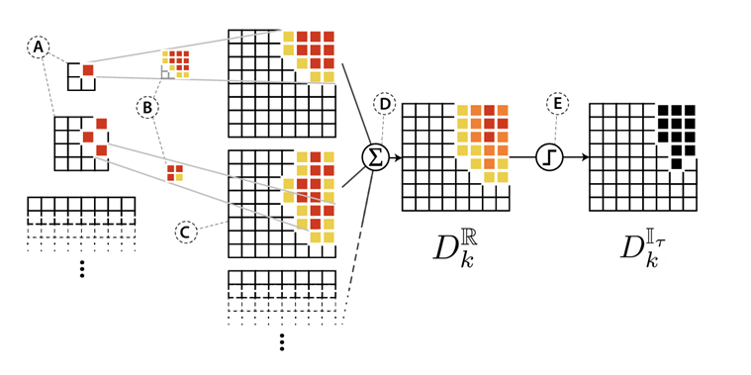
Approach
Leveraging Attention Mechanisms
DAAM uses attention maps to correlate text tokens with image regions
Heatmap Generation
Compiles scores from layers, heads, and time steps
Advancing Model Interpretability
Provides a more stable analysis of diffusion models’ text-to-image generation

Slide 5
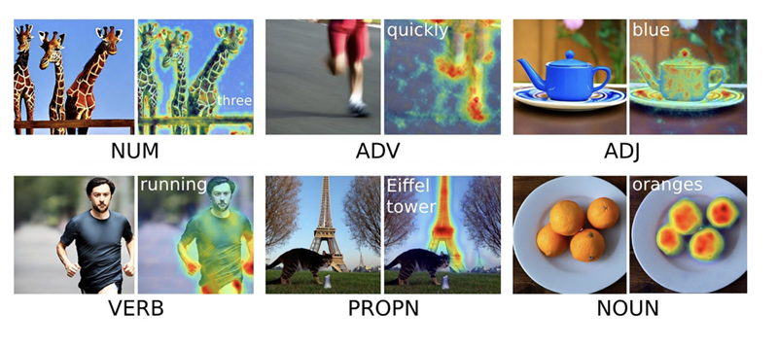
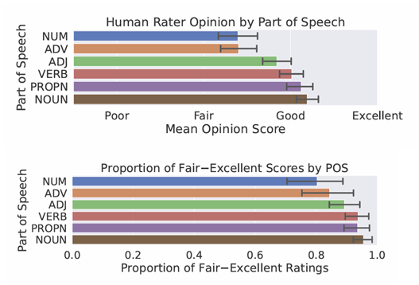
Attribution Analyses
Object Attribution
DAAM excels in segmenting datasets
Resilience to Noise
Remains effective even with nonsensical prompts
Human Evaluation
Over 90% of adjective, verb, and noun mappings rated as ‘fair’ to ‘excellent’

Slide 6
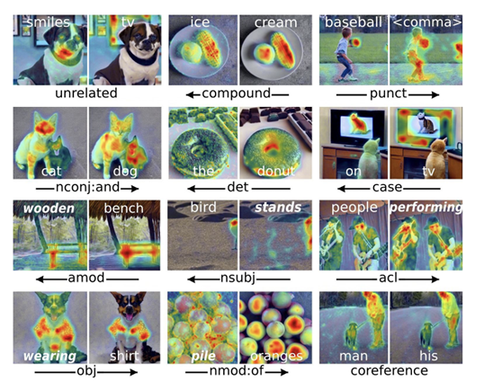
Visuosyntactic Analyses
Syntactic Relationships
Verbs influence outputs more than subjects or objects
Feature Entanglement
Adjectives overshadow nouns due to shared visual representation
Coreference Resolution
High overlap in DAAM maps for coreferent pairs

Slide 7
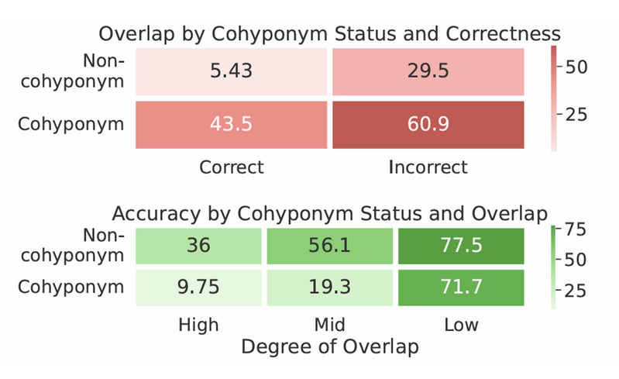
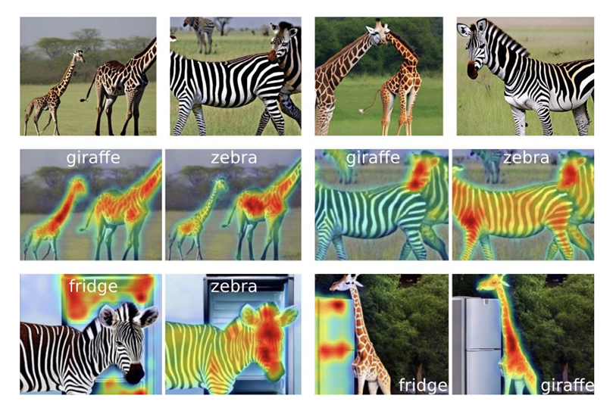
Visuosemantic Analyses
Cohyponym Entanglement
Semantically similar prompts result in feature competition, reducing generation accuracy

Slide 8
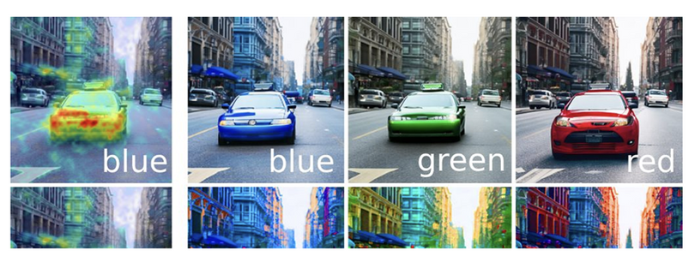
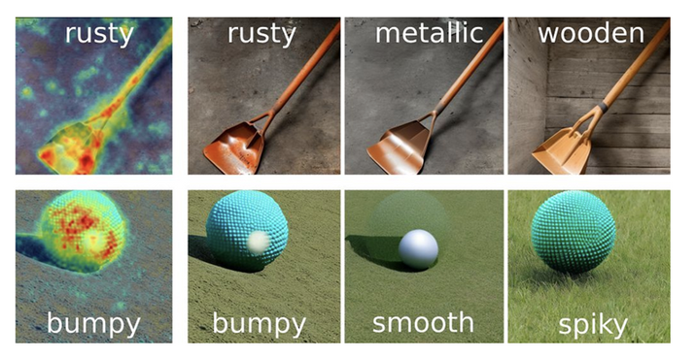
Visuosemantic Analyses
Adjectival Entanglement
Adjectives impact broader regions, altering scene attributes beyond their targets
Optimal Prompt Construction
Prompts with minimal feature overlap yield better visual results

Slide 9
Related Work and Future Directions
Intersection of Linguistics and AI
Explores syntax and semantics in shaping diffusion models’ outputs
Addressing Feature Entanglement
Insights into cohyponym competition and adjectival spillover guide model improvements
Applications in Prompt Engineering
DAAM paves the way for precision editing and advanced content generation

Slide 10

Strengths
Novel Approach
Introduces DAAM, uniquely combining linguistic and visual analysis for model interpretability
Rigorous Validation
Backed by quantitative and qualitative evaluations, leveraging diffusion model architectures
Broader Implications
Advances in robustness, fairness, and applications like content generation and editing

Slide 11
Weaknesses
Limited Scope
Applicability restricted to concrete datasets
Attention Map Validity
Reliance on attention maps questioned
No Mitigation Strategies
Identifies challenges like feature entanglement but lacks actionable solutions

Slide 12
Conclusions
Validated DAAM’s Accuracy
Proven through segmentation tasks and attribution studies
Insights on Feature Entanglement
Identified challenges like cohyponyms and adjectival spillover
Foundation for Future Research
Paves the way for improved models and practical applications

Slide 13

Questions for the Authors
How could DAAM be adapted to analyze abstract concepts or non-concrete terms in prompts?
What are the computational trade-offs and potential advancements needed to integrate gradient-based interpretability methods into diffusion model analysis?
What steps could be taken to address feature entanglement issues in cohyponyms and adjectives? Could existing techniques be adapted for efficient disentanglement?

Slide 14
Morph-fitting:
Fine-Tuning Word Vector Spaces with Simple Language-Specific Rules
Notes:
The following paper is Morph-fitting:
Fine-Tuning Word Vector Spaces with Simple Language-Specific Rules

Slide 15
Introduction
Major Challenges of Morphologically rich languages:
Handling low-frequency words
Distinguishing similar yet semantically opposite words.
Morph-fitting:
Generating morphological constraints based on language-specific rules.
Notes:
The primary goal of this paper is to address two major challenges posed by morphologically rich languages (such as German, Italian, etc.).
1. Difficulty in generating accurate representations for low-frequency word forms.
2. Insensitivity to lexical relations such as synonymy and antonymy.
Existing distributed word vector models are often insensitive to morphological information, which may result in incorrect modeling of semantic relationships.
To tackle these challenges, the paper aims to develop a resource-light, post-processing method called "Morph-fitting".
It leverages simple, language-specific morphological rules to enhance the quality of word embeddings, particularly for morphologically rich languages.
Let's see the key aspects of the method in next slide.

Slide 16
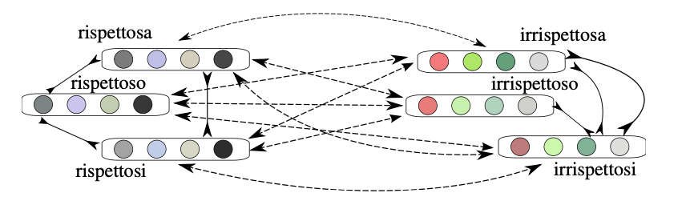
Approach
Input: Pre-trained Word Vectors
Standard distributional word embedding model (e.g., SGNS, GloVe).
Morphological Constraints
ATTRACT Constraints
REPEL Constraints
ATTRACT-REPEL Algorithm
ATTRACT Loss
REPEL Loss
Regularization Term
Notes:
First, Input: Pre-trained Word Vectors
The method starts with pre-trained word vectors generated using any standard distributional word embedding model, for example SGNS and GloVe.
These vectors are treated as the input space for fine-tuning.
Second, Morphological Constraints.
ATTRACT Constraints: Pairs of inflectional forms of the same word, for example look, looked, looking, are pulled closer in the vector space to emphasize similarity.
REPEL Constraints: Pairs of derivational antonyms, for example, expensive, inexpensive, are pushed further apart to distinguish opposite meanings.
These constraints are derived using simple 'if-then-else' rules specific to each language.
Third, The method uses the ATTRACT-REPEL algorithm, which modifies word vector spaces by iteratively optimizing a loss function with three components:
ATTRACT Loss: Pulls synonymous word pairs closer.
REPEL Loss: Pushes antonymous word pairs apart.
Regularization Term: Ensures the fine-tuned vectors retain the original semantic information encoded in the input vectors..

Slide 17
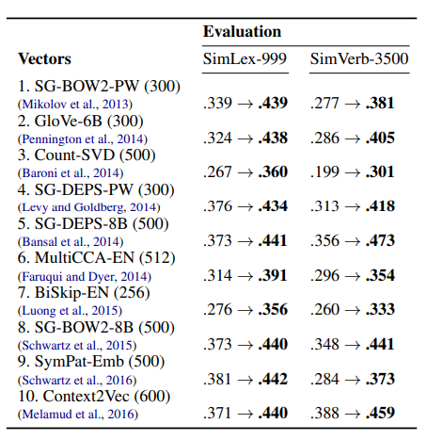
Evaluation
Intrinsic Evaluation
Spearman's rank correlation
Extrinsic Evaluation
dialogue state tracking (DST)
Comparison with Other Methods
compared to retrofitting and
counter-fitting
Notes:
I will introduce how the authors evaluate the differences between the different methods.
First, Intrinsic Evaluation:
For the intrinsic evaluation, the authors use Spearman's rank correlation to measure the semantic quality of word vectors on word similarity tests such as SimLex-999, SimVerb-3500.
The results show that the morph-fitted vectors consistently outperform both baseline and morph-fixed vectors across all tested languages.

Slide 18
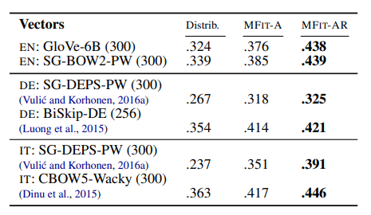
Evaluation
Intrinsic Evaluation
Spearman's rank correlation
Extrinsic Evaluation
dialogue state tracking (DST)
Comparison with Other Methods
compared to retrofitting and
counter-fitting
Notes:
The MFIT-AR variant, which includes both ATTRACT and REPEL constraints, achieves the best performance.

Slide 19
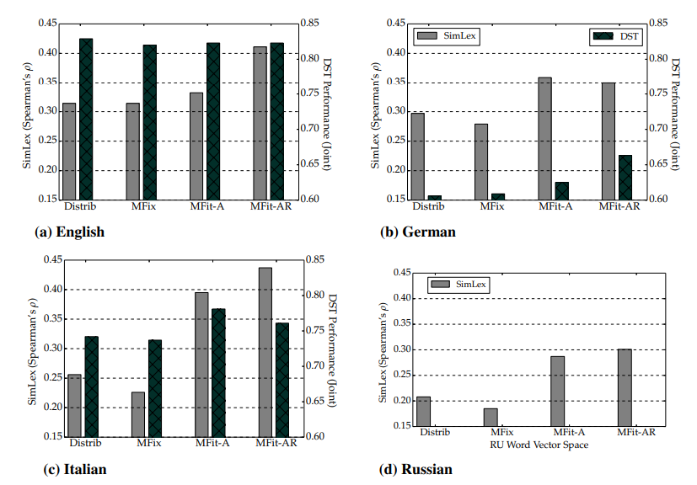
Evaluation
Intrinsic Evaluation
Spearman's rank correlation
Extrinsic Evaluation
dialogue state tracking (DST)
Comparison with Other Methods
compared to retrofitting and
counter-fitting
Notes:
Second, Extrinsic Evaluation:
The extrinsic evaluation looks at how these methods affect real-world tasks, especially dialogue state tracking (DST). The main measure used is joint goal accuracy, which checks how well the system can correctly identify all of the user's goals at each point in the conversation.
Morph-fitted vectors make a big difference in DST performance, especially for languages with rich morphology like German and Italian, achieving top-notch results. These improvements are related to, but not exactly the same as, the results from the word similarity tests, which shows that word similarity tests aren't always a perfect predictor of how well the system performs in real-world tasks.
3. Comparison with Other Methods:
The paper also compares its ATTRACT-REPEL model with two alternative post-processing methods: retrofitting and counter-fitting. In both intrinsic and extrinsic evaluations, ATTRACT-REPEL consistently outperforms these other methods. The better performance is attributed to ATTRACT-REPEL's context-sensitive vector space updates, whereas retrofitting and counter-fitting rely on pairwise updates that do not consider how each update affects the rest of the vector space.

Slide 20
Related Work and Future Directions
Semantic Specialization
Incorporate semantic constraints during training
Word Vectors and Morphology
Traditional methods often integrate morphological information during training
Innovations in Morph-fitting
Uses gold-standard morphological lexicons, morph-fitting achieves competitive performance
Notes:
I will discuss Related Work and Future Directions
let's start with semantic specialisation.
Semantic Specialisation
Most methods improve word vectors by either adding semantic constraints during training or injecting extra knowledge afterward, like retrofitting. But Morph-fitting takes a different approach as a post-processing method, using linguistic morphology as a low-cost way to improve semantic similarity.
Word Vectors and Morphology
Traditional methods include morphology directly in training, using tools like CELEX or Morfessor. Morph-fitting, on the other hand, applies inflectional and derivational rules after training, making it much simpler and easier to adapt.
Innovations in Morph-fitting
Morph-fitting stands out by using simple rules instead of relying on gold-standard lexicons, yet still achieves great results. It supports antonym constraints, can easily add other resources like WordNet, and has proven to be effective in real-world tasks like dialogue state tracking.

Slide 21
Strengths
Novel Approach
A novel way to leverage simple morphological rules to fine-tune word vector spaces
Enhancing Word Vectors Across Four Languages
Demonstrate the robustness and language-agnostic nature of morph-fitting
Implications for downstream tasks
Improves word embeddings, enhancing performance in tasks like machine translation and dialogue systems.
Notes:
Then, let's talk about the strengths of the paper.
Let’s begin with novelty. What makes this morph-fitting unique is that, unlike other approaches that depend on predefined semantic lexicons like WordNet, morph-fitting doesn’t need resource-intensive preprocessing. This allows it to work with a wider range of languages.
Additionally, the paper introduces ATTRACT and REPEL constraints. This adds a unique level of precision to the post-processing of word embeddings, making it an interesting and innovative approach.
Next, let’s talk about the soundness of the methodology. It extends previous methods with new post-processing techniques.This demonstrates the robustness and language-agnostic nature of morph-fitting by achieving consistent improvements across four languages, English, German, Italian, and Russian. The authors evaluate both intrinsic tasks, like word similarity, and extrinsic tasks, ensuring that the method is robust and applicable to different scenarios.
Finally, the significance of this paper is clear. It addresses the problem of current word embedding models not capturing the subtle morphological differences. By improving embeddings for low-frequency words and better capturing subtle meanings, this approach can be applied to areas like machine translation, dialogue systems, and semantic parsing.

Slide 22
Weaknesses
Limited Generality
The rules might not generalize well for more complex or irregular morphologies
Evaluation Gaps
Not convincingly demonstrate the utility of the approach for morphologically simpler languages like English
Limited Scalability
Require manual effort or domain expertise for new languages
Notes:
Here are the weaknesses of the paper.
Limited Generality
The method is unclear whether it can handle more complex morphological variations and irregular forms such as non-standard plurals, irregular verb conjugations, or other forms that don’t follow predictable patterns. This could significantly limit its generalizability when applied to highly irregular languages with extensive morphological variation.
Evaluation Gaps
Another limitation is in the evaluation. While the method shows great improvements for languages with rich morphology , it's not as convincing for simpler languages like English. This brings up questions about how well it can work across all types of languages.
Finally, Scalability is also a concern. Since the approach relies on specific rules, applying it to new languages requires manual effort or domain expertise, making it hard to be used in low-resource or under-researched languages.

Slide 23
Questions for the Authors
How does the method handle irregular forms that do not follow standard morphological patterns, such as 'go' and 'went'?
The paper mentions that some incorrect linguistic constraints (e.g., 'tent' and 'intent') may be generated. How significant is their impact on the overall model performance, and are there strategies to mitigate this issue?
For unknown languages, how can we confirm whether this method is applicable and scalable to that language?
Notes:
Here are three important questions to consider regarding the method
The method primarily relies on standard morphological rules, but how does it handle irregular forms that do not follow these patterns, such as "go" and "went"? These non-standard forms could pose challenges for the model, and it’s unclear how effectively it can handle such exceptions.
Next,
The paper mentions that some incorrect linguistic constraints, like "tent" and "intent," may be generated during the process. How significant is their impact on the overall model performance? Are there any strategies in place to identify or mitigate these errors to ensure the method’s robustness?
For languages that are not yet studied or for which there are limited resources, how can we confirm whether this method is applicable and scalable? The approach relies heavily on language-specific morphological rules, so verifying its effectiveness for new or low-resource languages is an important consideration for future use

Slide 24
SAPT: A Shared Attention Framework for Parameter-Efficient Continual Learning of Large Language Models
Notes:
The last paper is SAPT: A Shared Attention Framework for Parameter-Efficient Continual Learning of Large Language Models

Slide 25
Introduction
Shared Attention Framework (SAPT)
A new parameter-efficient continual learning framework that simultaneously addresses two key challenges CF and KT.
Catastrophic Forgetting (CF)
The loss of previously acquired knowledge when learning new tasks.
Knowledge Transfer (KT)
Efficiently utilizing knowledge from past tasks to learn new ones.
Notes:
I'll introduce SAPT, a framework designed to tackle two key challenges in continual learning: Catastrophic Forgetting (CF) and Knowledge Transfer (KT).
Catastrophic Forgetting (CF) happens when a model forgets previously learned knowledge while learning new tasks. Knowledge Transfer (KT) is about using knowledge from past tasks to help learn new ones. SAPT solves both by using a Shared Attention Framework, aligning the learning and selection processes to preserve old knowledge while effectively transferring useful information to new tasks.

Slide 26
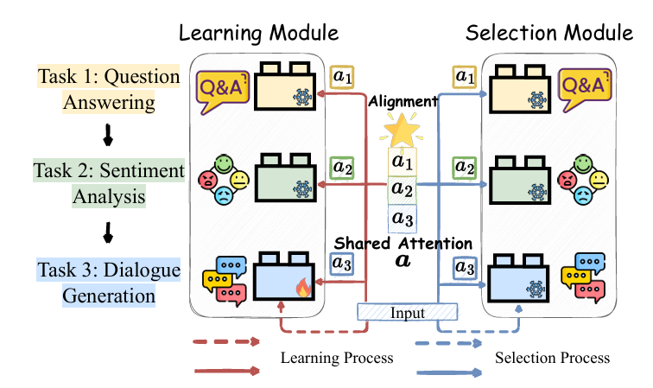
Approach
Shared Attentive Learning & Selection Module (SALS)
It dynamically selects and combines PET blocks based on input relevance using a unified shared attention mechanism.
Attentive Reflection Module (ARM)
It uses pseudo-samples to help SALS recall correct attention combinations for previous tasks, reducing forgetting.
Notes:
SAPT consists of two core components:
Shared Attentive Learning & Selection Module (SALS):
During training, dynamically selects and combines PET blocks based on input relevance using a shared attention mechanism.
During inference, automatically selects appropriate blocks to handle inputs via the same attention operation.
Attentive Reflection Module (ARM):
Utilizes generated pseudo-samples to help SALS "recall" the correct attention combinations for previous tasks, mitigating forgetting.

Slide 27
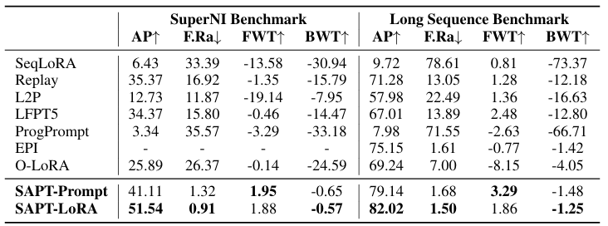
Overall Performance
Average Performance (AP)
Measures the model’s overall accuracy after training all tasks.
Forgetting Rate (F.Ra)
Quantifies how much prior knowledge is lost during training new tasks.
Forward Transfer (FWT)
Evaluates knowledge transfer to future tasks.
Backward Transfer (BWT)
Assesses how new tasks impact previously learned tasks.
Notes:
Experiments on SuperNI and Long Sequence Benchmarks show that:
SAPT significantly improves average performance (AP) while achieving the lowest forgetting rate (F.Ra), effectively mitigating catastrophic forgetting.
SAPT outperforms competitors in forward transfer (FWT) and backward transfer (BWT), indicating its capability to facilitate knowledge transfer.

Slide 28
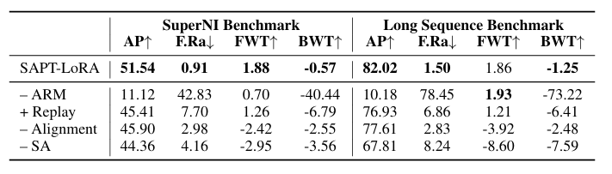
Ablation Studies
Without ARM
Performance drops significantly.
Removing alignment of learning and selection processes
increases forgetting
Notes:
Removing SAPT components demonstrates their critical contributions:
Without ARM, performance drops significantly, showing its role in recalling previous task attention distributions.
Removing alignment of learning and selection processes increases forgetting, proving their importance.

Slide 29
Power of Scale
Scaling to Larger Backbones
SAPT achieves better performance and less forgetting as model size grows.
Scaling Across Architectures
SAPT delivers robust performance across architectures, improving with increased model capacity.
Unseen Task Generalization
SAPT excels on unseen tasks, showcasing strong generalization and effective knowledge transfer.
Notes:
The experiments also evaluate SAPT's performance across different model sizes and architectures, revealing its scalability and effectiveness:
Scaling to Larger Backbones:
SAPT consistently improves average performance (AP) and reduces forgetting rate (F.Ra) as the model size increases. Notably, SAPT-LoRA (770M) outperforms larger models like O-LoRA (11B), highlighting the importance of efficient PET block selection over simply increasing model size.
Scaling Across Architectures:
SAPT performs robustly across different architectures (T5 and LLaMA-2), with performance improving as model capacity increases, demonstrating the framework's general applicability.
Unseen Task Generalization:
SAPT excels in cross-task generalization, achieving the best performance on unseen tasks across multiple categories, showcasing its strong knowledge transfer capabilities.

Slide 30
Related Work and Future Directions
Pruning Redundant PET Blocks
reduce computational and storage costs as tasks increase.
Enhancing Positive Backward Transfer (BWT)
Enabling new tasks to benefit previously learned ones.
Eliminating Task Identifier Dependence
Removing reliance on task identifiers could enable flexible, real-time continual learning without explicit task labels.
Notes:
Pruning Redundant PET Blocks:
Future research could explore methods to prune or merge similar PET blocks, reducing the computational and storage costs as the number of tasks grows.
Enhancing Positive Backward Transfer (BWT):
Research could focus on improving positive backward transfer, allowing new tasks to have a more beneficial effect on previously learned tasks.
Eliminating Task Identifier Dependence:
Investigating ways to remove the reliance on task identifiers during training would allow for more flexible, real-time continual learning without needing explicit task labels.

Slide 31
Strengths
Novel Approach
Shared Attention Framework (SAPT), a new parameter-efficient continual learning framework that simultaneously addresses.
Theoretical and Practical Validation
Based on parameter-efficient tuning, demonstrates robustness across diverse models, scales, and benchmarks through theoretical and experimental validation.
Broader Implications
SAPT outperforms state-of-the-art methods, enhancing performance and mitigating forgetting for impactful AI research.
Notes:
SAPT incorporates the Shared Attentive Learning & Selection (SALS) and Attentive Reflection Module (ARM), which align learning and selection processes through a shared attention mechanism. This is a novel perspective compared to prior works.
The SAPT framework is based on parameter-efficient tuning techniques (e.g., Prompt Tuning and LoRA), with its methodology rigorously validated through both theoretical analysis and empirical results.
And it offers practical solutions for deploying LLMs in real-world continual learning scenarios, especially when task identifiers are unavailable.
Experimental results reveal that SAPT significantly improves average performance (AP) while minimizing forgetting (F.Ra), outperforming state-of-the-art methods. This makes it highly impactful for future AI research.

Slide 32
Weaknesses
Limitation
As the number of tasks increases, expanding the PET pool may result in high computational and storage costs.
Scope of Experiments
The study does not address diverse application scenarios like multimodal tasks or real-time data streams.
Dependency on Task Identification
Although SAPT supports various architectures, its reliance on task identifiers during training may limit its use in applications with undefined task categories.
Notes:
Nevertheless, there are still some areas in this paper that could be further improved.
First, When the number of tasks increases significantly (e.g., hundreds of tasks), the expansion of the PET pool could lead to high computational and storage costs.
While SAPT improves backward transfer (BWT), it still fails to allow subsequent tasks to positively influence learned ones.
for the scope of experiments, The study does not explore more diverse application scenarios, such as multimodal tasks (e.g., image-text) or real-time online data streams.
Although SAPT supports different architectures, it relies on task identifiers during training, which may limit its usability in applications where task categories are undefined.

Slide 33
Conclusions
Effective Alignment of Learning and Selection
Simultaneously addressing Catastrophic Forgetting (CF) and Knowledge Transfer (KT)
No Task Identifiers Required for Testing
It functions effectively in real-world scenarios without task identifiers during testing, enhancing its practical applicability.
Broad Applicability
SAPT shows strong performance across various tuning methods, model architectures (T5, LLaMA-2), and scales (770M to 13B parameters).
Notes:
SAPT successfully aligns parameter-efficient block learning and block selection through shared attention, simultaneously addressing Catastrophic Forgetting (CF) and Knowledge Transfer (KT).
And it also operates effectively in practical scenarios where task identifiers are unavailable during testing, making it more suitable for real-world applications.
SAPT demonstrates robust performance across diverse parameter-efficient tuning methods, model architectures (T5, LLaMA-2), and scales (from 770M to 13B parameters).

Slide 34
Questions for the Authors
Can SAPT effectively handle multimodal data (e.g., text and image combinations)? If not, what modifications would you suggest to extend its capabilities?
For longer task sequences (e.g., over 100 tasks), have you considered techniques to prune or merge similar PET blocks to reduce storage and computational overhead?
How could SAPT be adapted for online continual learning scenarios where task identifiers are unavailable during both training and testing?
Notes:
There are three questions for the authors:
In exploring the potential of SAPT, several key questions arise. First, can SAPT handle multimodal data, such as text and image combinations? Currently, SAPT is focused on language models, but extending it to multimodal tasks would likely require modifications to integrate different data types effectively, perhaps by adapting the shared attention mechanism to handle both textual and visual features.
Second, for scenarios involving long task sequences—over 100 tasks—have we considered pruning or merging similar PET blocks to reduce storage and computational overhead? This could be a valuable strategy to maintain efficiency as the number of tasks grows, and implementing block merging techniques could significantly reduce resource demands.
Lastly, how could SAPT be adapted for online continual learning, where task identifiers are unavailable during both training and testing? To address this, SAPT might need to incorporate unsupervised or self-supervised learning techniques, allowing it to learn and adapt without explicit task labels, making it more suitable for real-world, dynamic environments.

Slide 35


